Slide 1
Writing a Simple Report
Modul Bahasa Inggris XII

Slide 2
Indicator
Students should be able to understand about report.
Students should be able to understand about the structure of report
Students should be able to write a simple report

Slide 3
Purpose
Able to explain the understanding of report
Able to explain the generic structure of report
Able to write a simple report.

Slide 4
Material
A report is a paper written by a person or group of people with the aim of being a proof of responsibility for carrying out the tasks assigned.
In order to be used as a material for consideration or decision making, a report must contain correct, objective, and systematic data.
Definition of Report

Slide 5
Material
As with any essay in general, the report must be submitted in a good and systematic form and structure. Good form is related to writing technique, while structure is related to the organization. Therefore the structure of the report, especially in the form of a book, must be supplemented by standard elements. General report structure elements that apply in the preparation of reports include:
Cover
Preface
Content
Closing
Appendix
B. Generic Structure of Report

Slide 6
Material
Some ways to make a good and correct report are:
Choose the topic
Conduct Activity Research
Creating a Framework
Start to write Report
Editing Report
C. How to Write a Simple Report

Slide 7
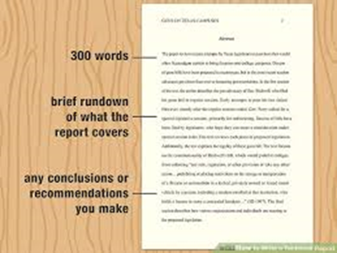
Example
A Simple Report

Slide 8
Assignment
Acknowledgment:
Answer the questions below:
In creating a report needs a lot of things that must be paid for attention. Sometimes, the steps in creating a report make confuse for the beginners of writer. Therefore, they got obstacles. Mention the obstacles and the solving problem that you know well.
Life skill
Create a simple report of your own job sheet!

Slide 9

Thank you

